Slide 1
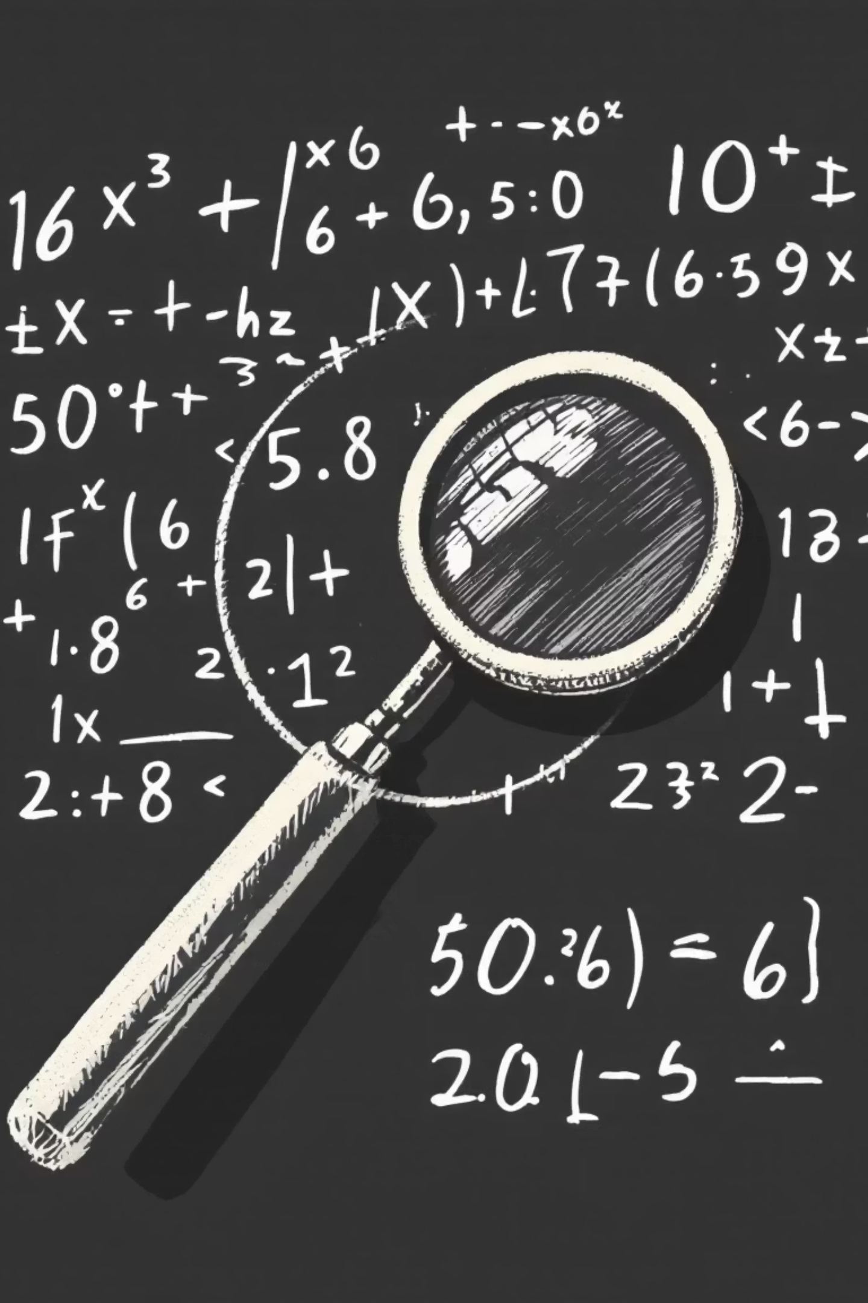
Proof by Contradiction: A Powerful IB Math AA Tool

Slide 2

What is Proof by Contradiction?
Indirect Proof Method
The Core Idea
Concluding the Truth
A technique to establish the truth of a statement by demonstrating that assuming its falsity leads to a logical impossibility or inconsistency.
Instead of directly proving statement P, one begins by assuming the negation of P (denoted as ¬P) to be true. This assumption is then used to derive a contradiction.
Once a contradiction is reached, it logically follows that the initial assumption (¬P) must be false. Therefore, the original statement P must inherently be true.

Slide 3
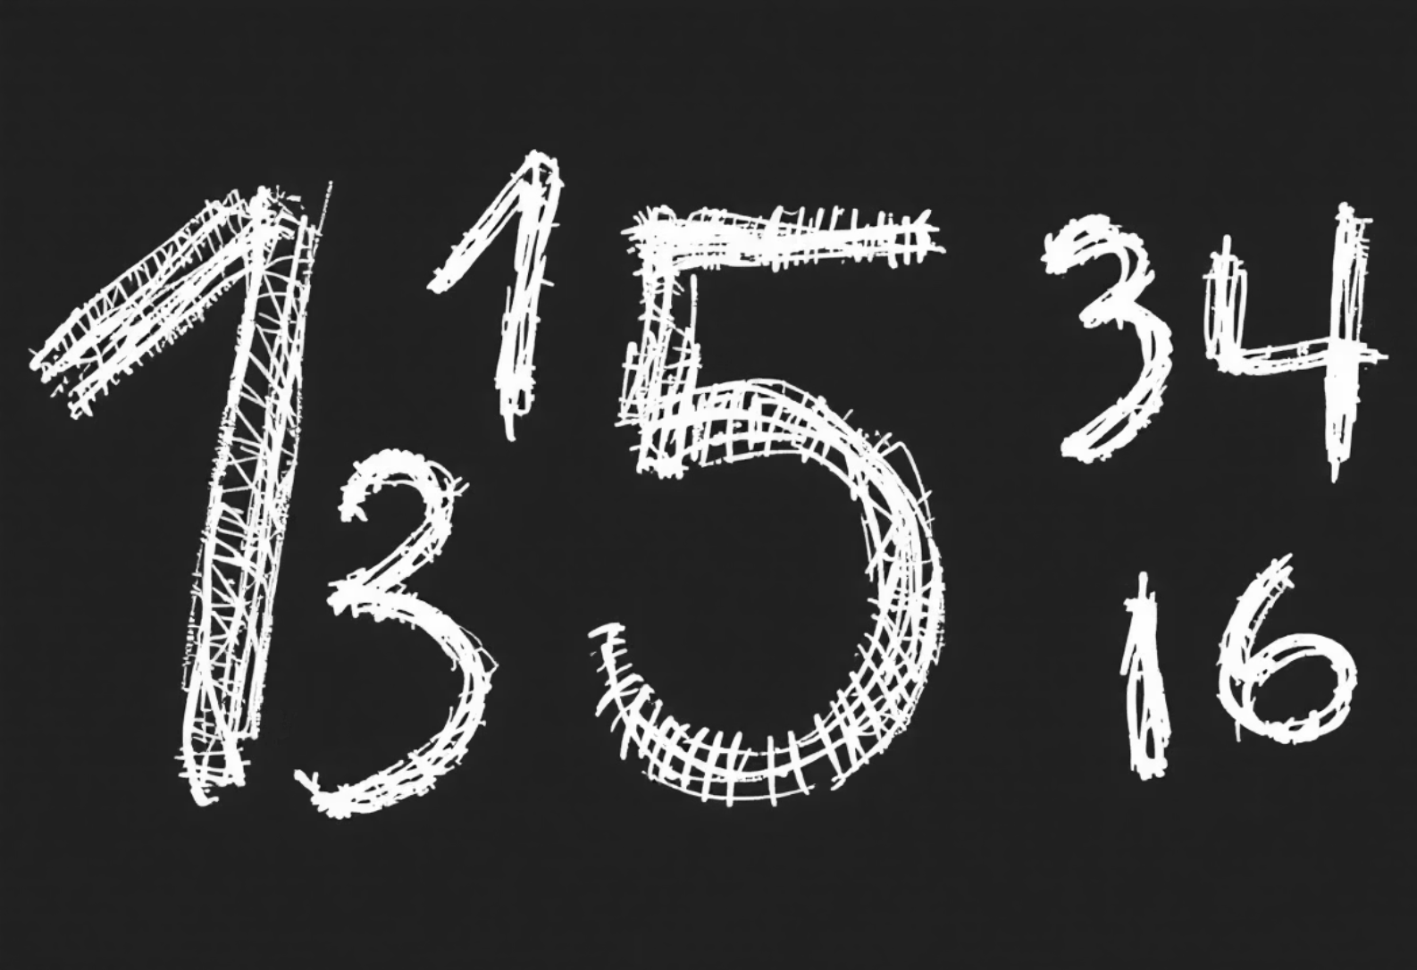
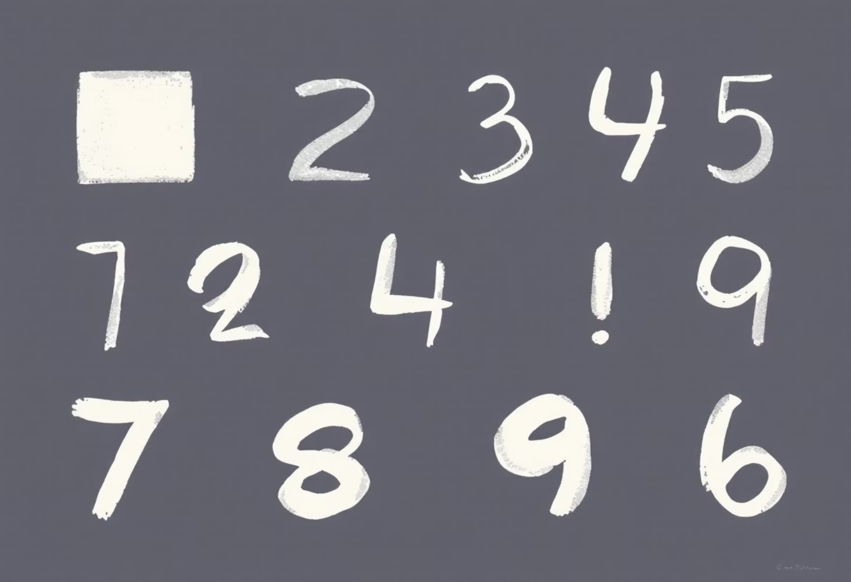
Understanding Negation: Flipping Statements
Negation is the process of forming a statement that is the opposite of the original statement, making it logically false if the original is true, and true if the original is false.
"All integers are even"
"If n² is even, then n is even"
Negation: "There exists at least one integer that is not even."
Negation: "n² is even AND n is odd." (The condition is true, but the conclusion is false)
Key Principle: When negating universal statements ("all"), switch to existential ("there exists") and negate the condition, and vice versa. For conditional statements, negate the conclusion while keeping the condition.

Slide 4
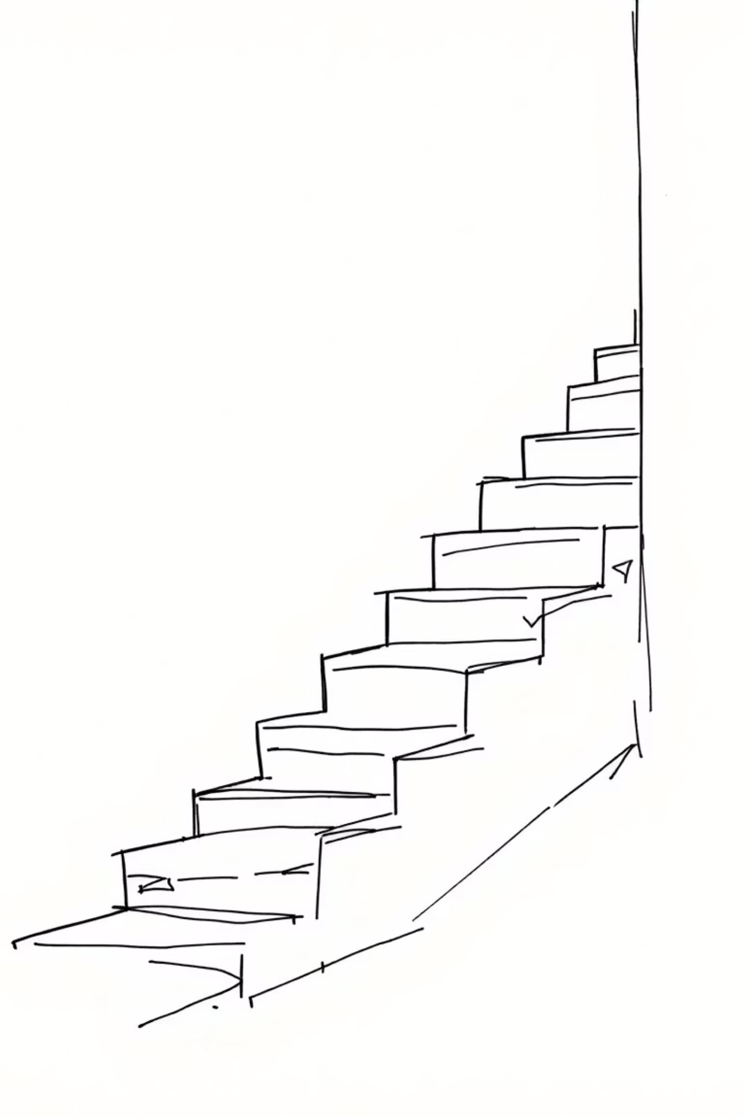
Steps for Proof by Contradiction
01
Assume the Opposite
Start by assuming that the negation (or opposite) of the statement you want to prove is true.
02
Derive Consequences
Using valid mathematical operations, logic, and definitions, explore the implications of your initial assumption. Develop a chain of reasoning.
03
Identify the Contradiction
Look for a point where your derived consequences clash with a known mathematical fact, a definition, or even your own initial assumption. This clash is the contradiction.
04
Conclude Original Statement
Since the assumption of the negation led to an impossible situation, it must be false. Therefore, the original statement you set out to prove must be true.

Slide 5
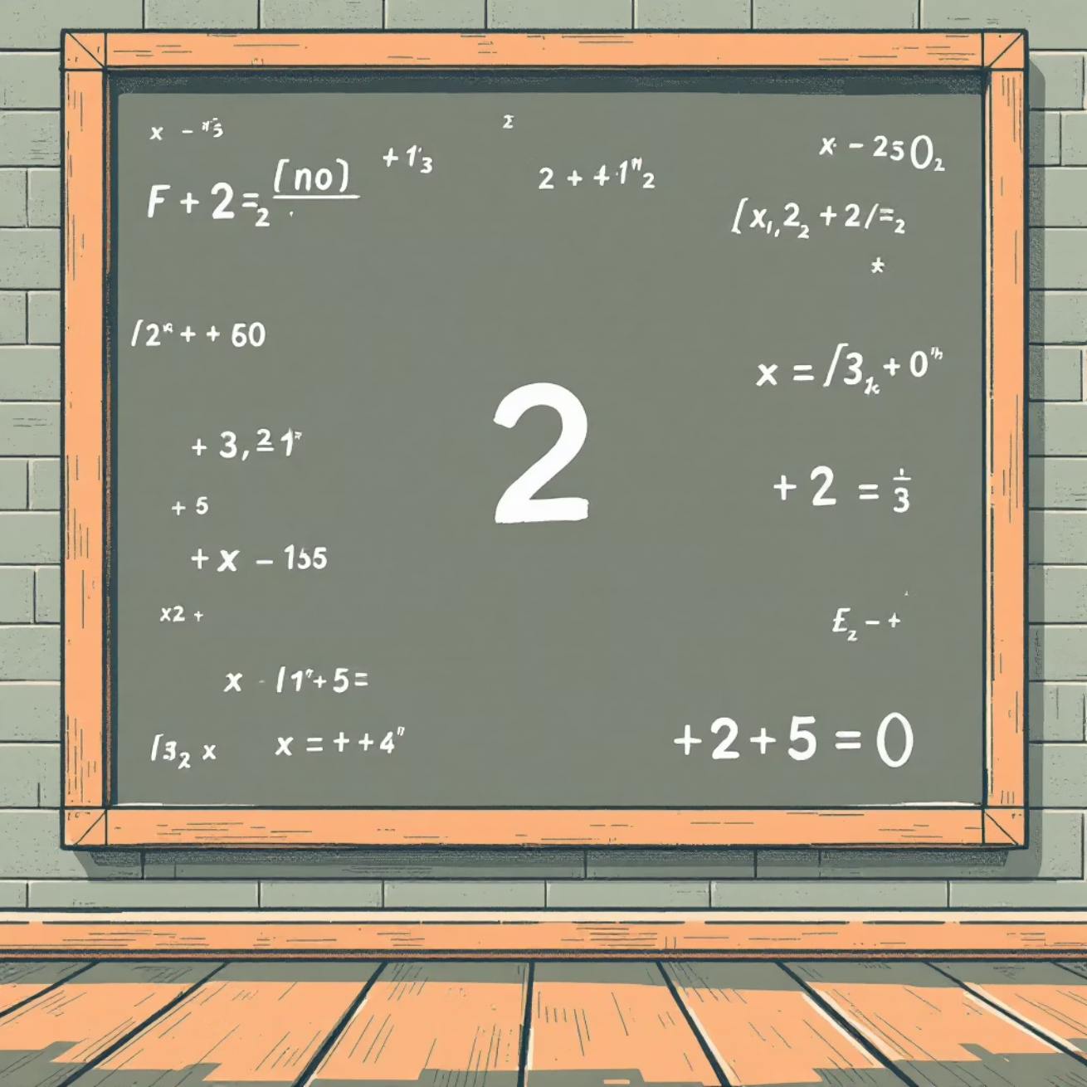

Example 1: Prove √2 is Irrational
The Setup
We want to prove that \sqrt{2} is irrational. We start by assuming the opposite: that \sqrt{2} is rational. This means it can be expressed as a fraction a/b, where a and b are integers, b \neq 0, and a and b have no common factors (it's in simplest form).
The Derivation
Squaring both sides gives 2 = a^2/b^2, so 2b^2 = a^2. This implies a^2 is an even number. If a^2 is even, then a itself must be even. We can write a as 2m for some integer m.
Substituting a = 2m back into the equation: 2b^2 = (2m)^2 = 4m^2. Dividing by 2, we get b^2 = 2m^2. This means b^2 is even, and consequently, b must also be even.
The Contradiction
We have concluded that both a and b are even. However, our initial assumption stated that a and b have no common factors. If both are even, they share a common factor of 2, which contradicts our premise.
The Conclusion
Since our assumption that \sqrt{2} is rational leads to a contradiction, the assumption must be false. Therefore, \sqrt{2} must be irrational.

Slide 6
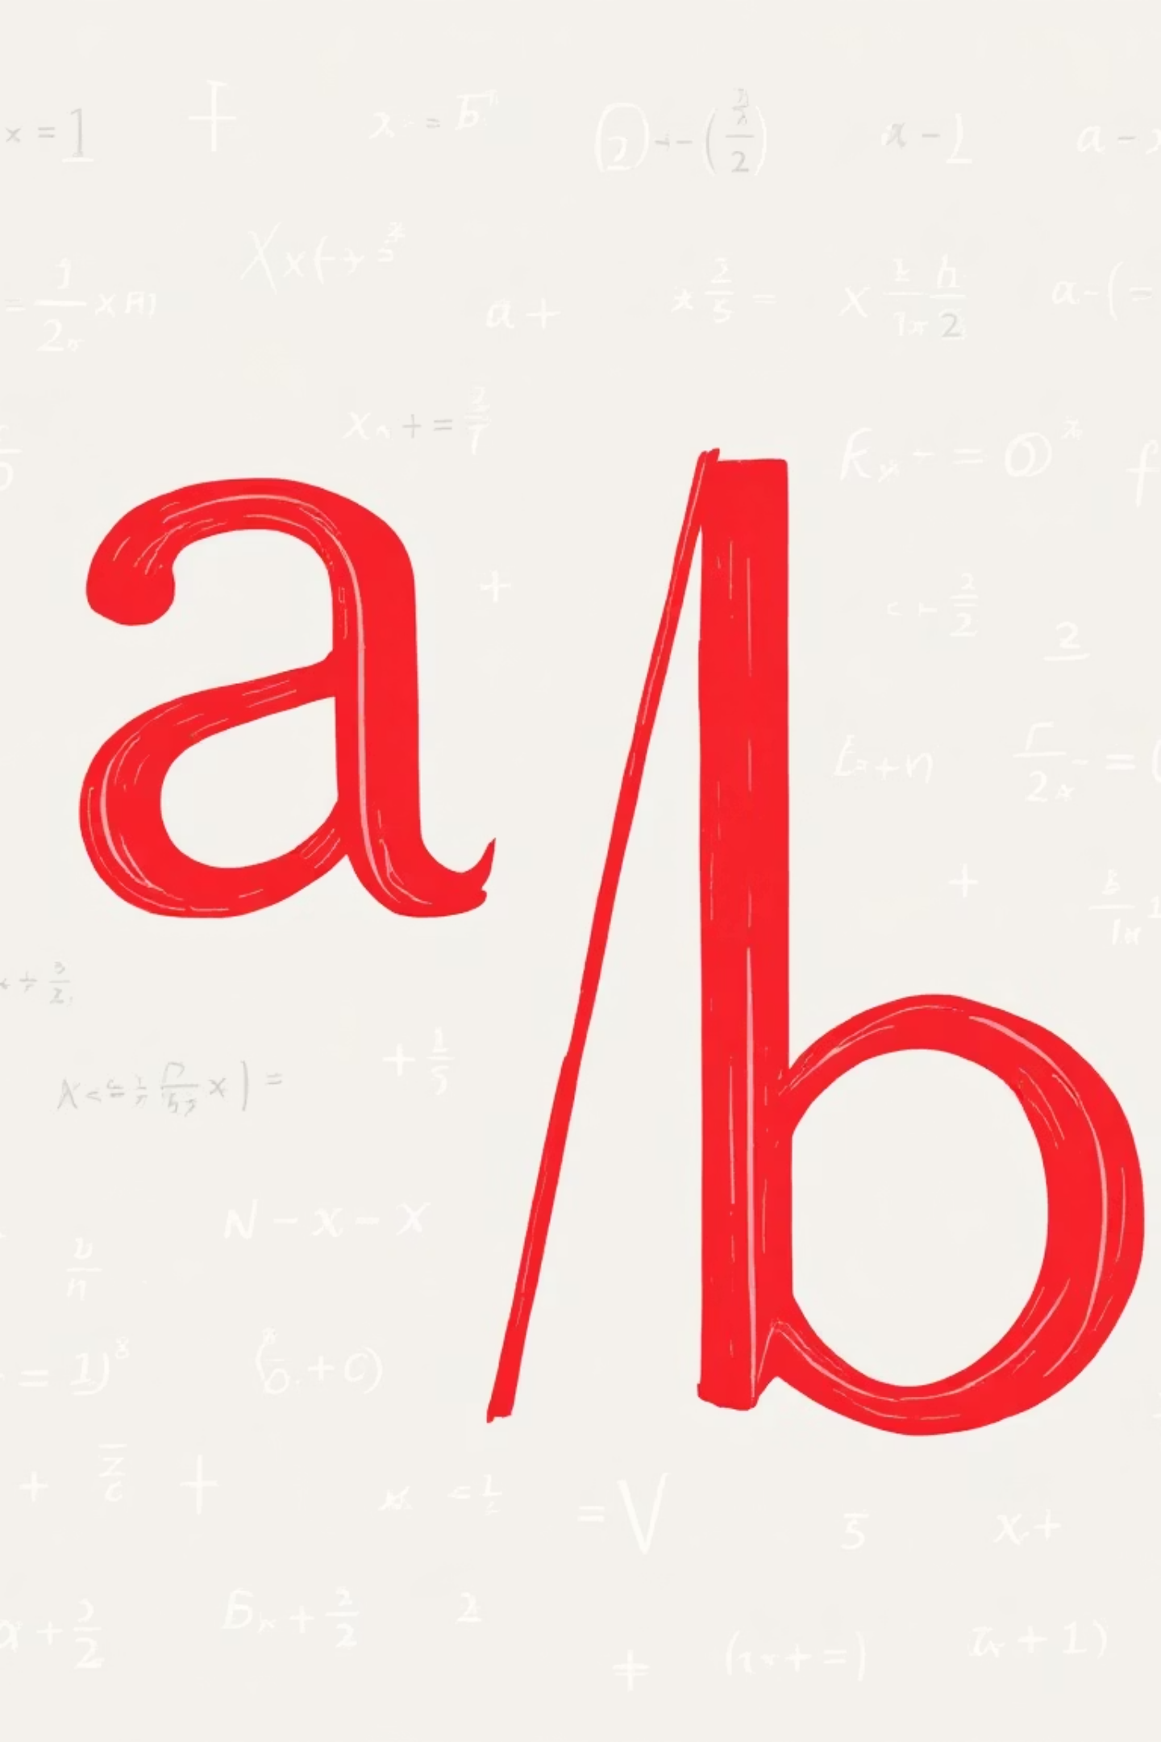
Visual Moment: The Flaw in the Fraction
No simplest form possible — contradiction!
This image dramatically illustrates the breakdown of the initial assumption. If a and b are both even, the fraction can always be simplified, violating the condition that it started in simplest form.

Slide 7

Example 2: If n² is even, then n is even
Initial Assumption
Representing n as Odd
Assume the negation: n² is even, but n is odd. This sets up the scenario for contradiction.
If n is odd, it can be written in the form n = 2k + 1 for some integer k.
Calculating n²
The Contradiction
Substituting n = 2k + 1 into n^2: n^2 = (2k + 1)^2 = 4k^2 + 4k + 1 = 2(2k^2 + 2k) + 1.
The result 2(2k^2 + 2k) + 1 clearly shows that n^2 is odd, which directly contradicts our initial assumption that n² is even.
Therefore, the assumption that n is odd must be false. If n^2 is even, then n must be even.

Slide 8
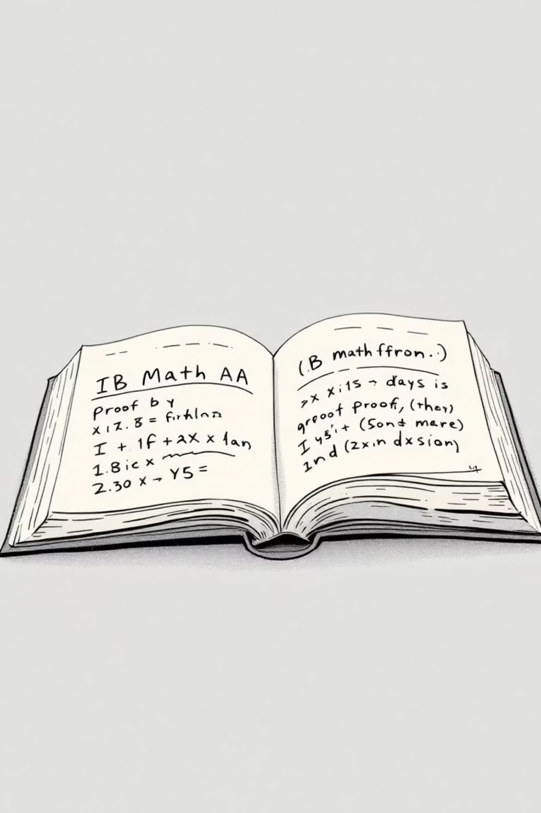
Why Use Proof by Contradiction in IB Math AA?
Simplifies Complexity
It's invaluable when direct proof methods become overly complicated, obscure, or impossible to construct. It offers an alternative pathway to truth.
Unique Applications
Often the only viable method for proving statements related to concepts like irrational numbers, properties of prime numbers, parity (even/odd), and properties of infinite sets.
Enhances Logical Reasoning
Mastering this technique sharpens critical thinking and deepens understanding of fundamental mathematical structures and logical inference, essential skills for IB Math AA.

Slide 9

Common Pitfalls & Tips
Clear Negation
Contradiction Hunt
Always explicitly and precisely state the negation of the original statement you are assuming to be true. Ambiguity here can derail the entire proof.
Be vigilant for contradictions relating to fundamental properties like parity (even/odd), divisibility rules, definitions, or established mathematical theorems. The contradiction must be undeniable.
The Nature of Contradiction
Practice Makes Perfect
A contradiction occurs when you arrive at a statement that is both true and false simultaneously, or when two mutually exclusive statements are both shown to hold. This logical impossibility confirms your initial assumption was incorrect.
Regularly work through classic examples like the irrationality of \sqrt{2} or the infinitude of prime numbers to build intuition and proficiency with the method.

Slide 10
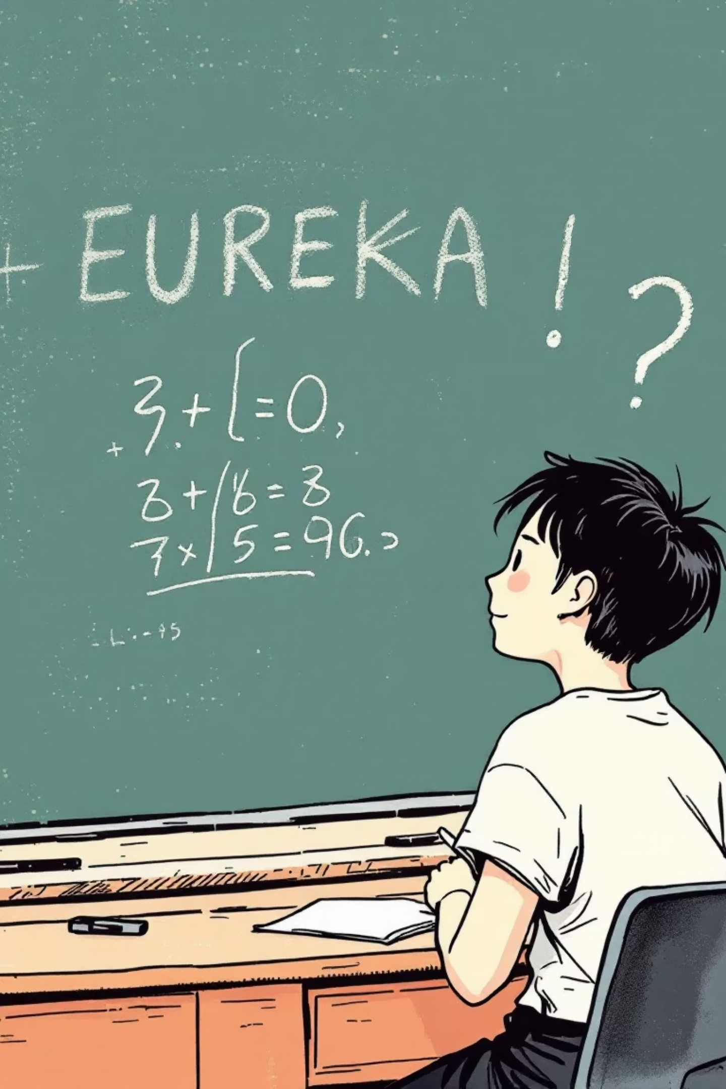
Summary & Takeaway
Assume, Contradict, Conclude
IB Math AA Essential
The essence of proof by contradiction: assume the opposite of what you want to prove, logically derive an impossibility, and conclude your original statement must be true.
A fundamental skill for tackling proofs, particularly those involving irrational numbers, divisibility properties, and other complex mathematical concepts in the IB Math AA curriculum.
Mastery for Success
Developing proficiency in this method will empower you to solve challenging problems and demonstrate a sophisticated understanding of mathematical reasoning to examiners.
Ready to try? Start with simple statements and build up your confidence! The journey to mastering proof by contradiction begins now.

